Slide 1
CS 547
Week 1 Day 2
More PHP Language Constructs

Slide 2
Agenda
Announcements
Brief Review
PHP Language Continued

Slide 3
Announcements
First project next details next class

Slide 4
Review
Development Tools
XAMPP from apachefriends.org

Slide 5
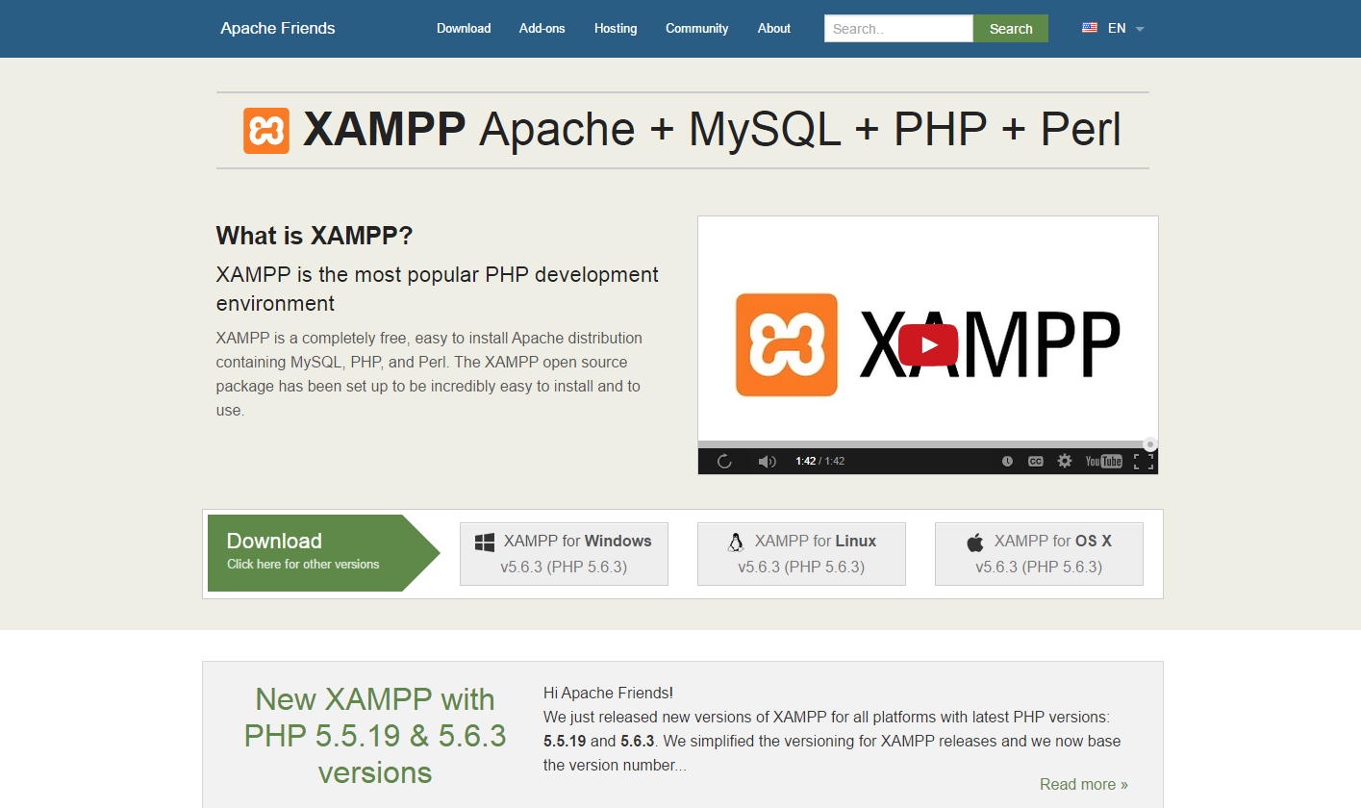
Dev Tools: Download
Download XAMPP from ApacheFriends.Org web site.

Slide 6
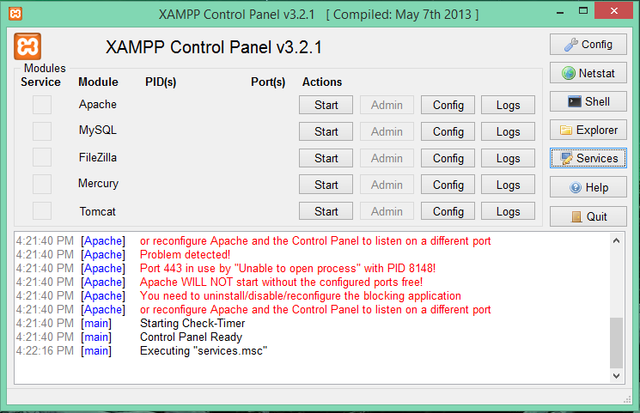
XAMPP Control Panel
Last time we talked about Apache
Today we will dive into MySQL

Slide 7
PHP Language

Slide 8
PHP Language
Review: Last session we discussed
Basics
Syntax
Simple variables

Slide 9
PHP Language
Today:
Variables Continuation…
Arrays
Operators
Control Structures
Special Functions

Slide 10
PHP Variables
PHP is a loosely typed language
$index = 1;
…
$index = “One”;
These variables are referred to as Scalar variables.
Scalar variables contain only one value

Slide 11
PHP Variables: Data Types
PHP has the following Data Types
String
Integers
Floats or Doubles
Booleans: true , false
Arrays
Objects
Null
Resource

Slide 12
PHP Variables: String
<?php $a = "Hello world.";
echo $a; echo "<br>";
?>

Slide 13
PHP Variables: String Concatenation
<?php $a = "Hello”
$b = “world.";
echo $a . $b; echo "<br>";
?>
Helloworld

Slide 14
PHP Variables: String Concatenation
<?php $x = "Hello”
$b = “world.";
echo $x .” “. $b; echo "<br>";
?>
Hello world

Slide 15
PHP Variables: Integer
An integer is a whole number (without decimals). It is a number between -2,147,483,648 and +2,147,483,647.
Rules for integers:
An integer must have at least one digit (0-9)
An integer cannot contain comma or blanks
An integer must not have a decimal point
An integer can be either positive or negative

Slide 16
PHP Variables: Integer
Integers can be specified in three formats:
decimal (10-based) 1234567890
hexadecimal (16-based - prefixed with 0x) 0x00af
octal (8-based - prefixed with 0) 0777

Slide 17
PHP Variables: Integer
<?php $a = “101";
echo $a; echo "<br>";
var_dump($a);
?>
101
Int(101)
Notes:
The PHP var_dump() function returns the data type and value.

Slide 18
PHP Variables: Float
A number that contains a decimal
<?php $a = “101.01";
echo $a; echo "<br>";
var_dump($a);
?>
101.01
Float(101.01)
Notes:
A float (floating point number) is a number with a decimal point or a number in exponential form.

Slide 19
PHP Variables: Boolean
Binary states : true or false
<?php $a = true;
echo $a; echo "<br>";
echo !$a;
?>
true
false
Notes:
A float (floating point number) is a number with a decimal point or a number in exponential form.

Slide 20
PHP Variables: Arrays
An array stores multiple values in one single variable.
<?php $fruits = array(“Apple",“Banana",“Kiwi"); var_dump($fruits); ?>
array(3) { [0]=> string(5) "Apple" [1]=> string(6) "Banana" [2]=> string(4) “Kiwi" }

Slide 21
PHP Variables: Arrays
We will examine arrays in greater depth…

Slide 22
PHP Variables: Objects
Objects are data structures that contain data and methods.
Must be explicitly declared using a class.

Slide 23
PHP Variables: Objects
<?php class Fruit { function Fruit() { $this->type = “Strawberry"; } } // create an object $myFruit = new Fruit(); // show object properties echo $myFruit >type; ?>
Strawberry

Slide 24
PHP Variables: Objects
We will examine objects in greater depth…

Slide 25
PHP Variables: Null
Null is a special data type which can have only one value: null
A variable of data type null is a variable that has no value assigned to it.
Remember that a variable created without a value is automatically assigned a value of null.
Variables can also be emptied by setting the value to null

Slide 26
PHP Variables: Null
<?php $a = “Hello Class!";
echo $a;
$a = null; echo "<br>";
var_dump($a);
?>
Hello Class!
NULL

Slide 27
PHP Variables: Resource
The special resource type is not an actual data type.
It is the storing of a reference to functions and resources external to PHP.
A common example of using the resource data type is a database call.
Notes:
We will not be discussing resource types. I include it here only for completeness.

Slide 28
PHP Operators
Operators are used to perform operations on variables and values.
Arithmetic operators
Assignment operators
Comparison operators
Increment/Decrement operators
Logical operators
String operators
Array operators
Notes:
These are the basic one in any language not just php. Know these for the test.

Slide 29
PHP Operators: Arithmetic
Operator | Name | Example | Result
+ | Addition | $x + $y | Sum of $x and $y
- | Subtraction | $x - $y | Difference of $x and $y
* | Multiplication | $x * $y | Product of $x and $y
/ | Division | $x / $y | Quotient of $x and $y
% | Modulus | $x % $y | Remainder of $x divided by $y
** | Exponentiation | $x ** $y | Result of raising $x to the $y'th power (Introduced in PHP 5.6)
Notes:
The PHP arithmetic operators are used with numeric values to perform common arithmetical operations, such as addition, subtraction, multiplication etc.

Slide 30
PHP Operators: Assignment
Assignment | Same as... | Description
x = y | x = y | The left operand gets set to the value of the expression on the right
x += y | x = x + y | Addition
x -= y | x = x - y | Subtraction
x *= y | x = x * y | Multiplication
x /= y | x = x / y | Division
x %= y | x = x % y | Modulus

Slide 31
PHP Operators: Comparison
Operator | Name | Example | Result
== | Equal | $x == $y | Returns true if $x is equal to $y
=== | Identical | $x === $y | Returns true if $x is equal to $y, and they are of the same type
!= | Not equal | $x != $y | Returns true if $x is not equal to $y
<> | Not equal | $x <> $y | Returns true if $x is not equal to $y
!== | Not identical | $x !== $y | Returns true if $x is not equal to $y, or they are not of the same type
> | Greater than | $x > $y | Returns true if $x is greater than $y
< | Less than | $x < $y | Returns true if $x is less than $y
>= | Greater than or equal to | $x >= $y | Returns true if $x is greater than or equal to $y
<= | Less than or equal to | $x <= $y | Returns true if $x is less than or equal to $y
Notes:
used to compare two values (number or string)

Slide 32
PHP Operators: Increment Decrement
Operator | Name | Description
++$x | Pre-increment | Increments $x by one, then returns $x
$x++ | Post-increment | Returns $x, then increments $x by one
--$x | Pre-decrement | Decrements $x by one, then returns $x
$x-- | Post-decrement | Returns $x, then decrements $x by one
Notes:
These come in really handy to make code more compact.

Slide 33
PHP Operators: Logical
Operator | Name | Example | Result
and | And | $x and $y | True if both $x and $y are true
or | Or | $x or $y | True if either $x or $y is true
xor | Xor | $x xor $y | True if either $x or $y is true, but not both
&& | And | $x && $y | True if both $x and $y are true
|| | Or | $x || $y | True if either $x or $y is true
! | Not | !$x | True if $x is not true
Notes:
Used for conditional statements

Slide 34
PHP Operators: String
Operator | Name | Example | Result
. | Concatenation | $txt1 . $txt2 | Concatenation of $txt1 and $txt2
.= | Concatenation assignment | $txt1 .= $txt2 | Appends $txt2 to $txt1
Notes:
Two special string operators, plus a bunch of functions we’ll come back to.

Slide 35
PHP Operators: Array
Operator | Name | Example | Result
+ | Union | $x + $y | Union of $x and $y
== | Equality | $x == $y | Returns true if $x and $y have the same key/value pairs
=== | Identity | $x === $y | Returns true if $x and $y have the same key/value pairs in the same order and of the same types
!= | Inequality | $x != $y | Returns true if $x is not equal to $y
<> | Inequality | $x <> $y | Returns true if $x is not equal to $y
!== | Non-identity | $x !== $y | Returns true if $x is not identical to $y
Notes:
Six build in operators, plus a few cool functions to help.

Slide 36
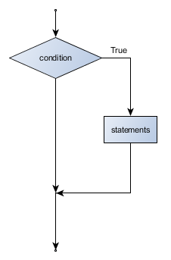
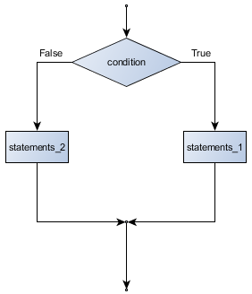
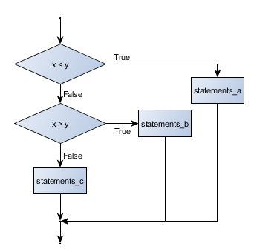
PHP Conditional Statements
PHP uses conditional statements to control the execution of code based on different conditions.

Slide 37
PHP If statement
Executes code only if condition is true
<?php $t = date("H"); if ($t < "20") { echo "Have a good day!"; } ?>
Notes:
will output "Have a good day!" if the current time (HOUR) is less than 20:

Slide 38
PHP If .. Else Statements
Use if there are two logical paths for your code…
<?php $t = date("H"); if ($t < "20") { echo "Have a good day!"; // path 1 } else { echo "Have a good night!"; // path 2 } ?>
Notes:
Will print have a good day or night depending on the hour when the code is executed.

Slide 39
if… elseif … else Statement
Used to specify a new condition to test, if the first condition is false.
if (condition) { code to be executed if condition is true; } elseif (condition) { code to be executed if condition is true; } else { code to be executed if condition is false; }

Slide 40
if… elseif … else Statement
<?php $t = date("H"); if ($t < "10") { echo "Have a good morning!"; } elseif ($t < "20") { echo "Have a good day!"; } else { echo "Have a good night!"; } ?>

Slide 41
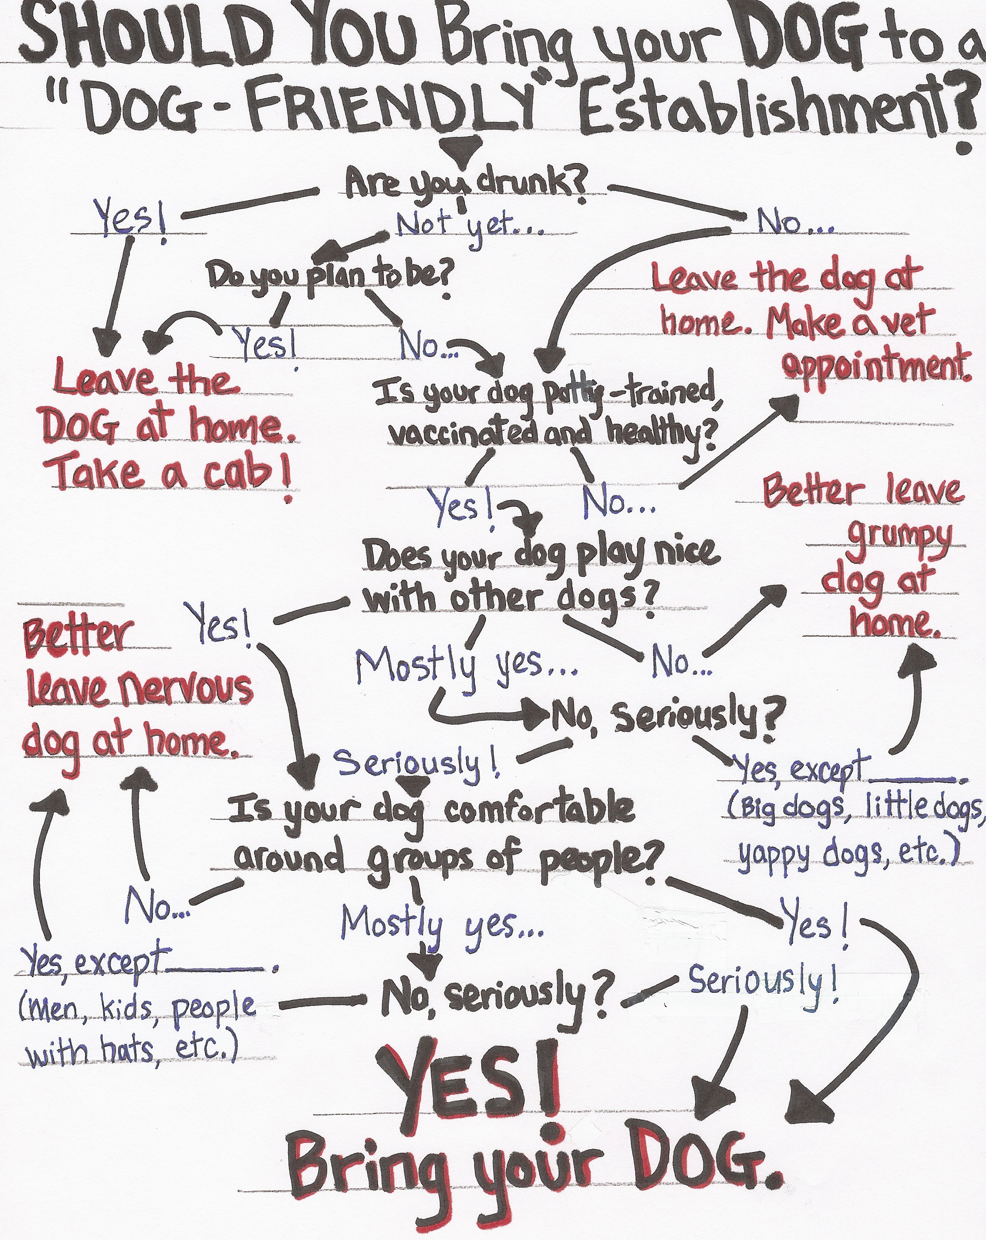
Multiple if… elseif … else Statement
One can ‘chain’ multiple if… else… elseif
statements together. But consider this image.
There is a better way…

Slide 42
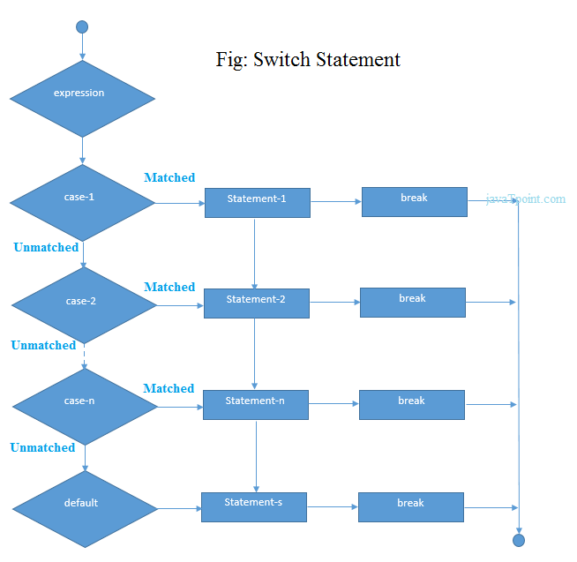
PHP Switch Stmt
The switch statement is used to select one of many blocks of code to be executed.
switch (n) { case label1: code to be executed if n=label1; break; case label2: code to be executed if n=label2; break; case label3: code to be executed if n=label3; break; ... default: code to be executed if n is different from all labels; }
Notes:
Same a the C switch statement

Slide 43
PHP Switch Statement
<?php $favcolor = "red"; switch ($favcolor) { case "red": echo "Your favorite color is red!"; break; case "blue": echo "Your favorite color is blue!"; break; case "green": echo "Your favorite color is green!"; break; default: echo "Your favorite color is neither red, blue, or green!"; } ?>
Notes:
Same a the C switch statement

Slide 44
PHP Loops
PHP provides the following constructs for loop
while - loops through a block of code as long as the specified condition is true
do...while - loops through a block of code once, and then repeats the loop as long as the specified condition is true
for - loops through a block of code a specified number of times
foreach - loops through a block of code for each element in an array

Slide 45
PHP While Loop
Syntax
while (condition is true) { code to be executed; }
<?php $x = 1; while($x <= 5) { echo "The number is: $x <br>"; $x++; } ?>
The number is: 1 The number is: 2 The number is: 3 The number is: 4 The number is: 5
Notes:
Test the condition once at the Top of the loop

Slide 46
PHP do … while Loop
Syntax
do { code to be executed; }
<?php $x = 1; do { echo "The number is: $x <br>"; $x++; } while ($x <= 5); ?>
The number is: 1 The number is: 2 The number is: 3 The number is: 4 The number is: 5
Notes:
The condition is tested AFTER executing the statements within the loop. This means that the do while loop would execute its statements at least once, even if the condition is false the first time

Slide 47
PHP for Loop
Syntax
for (init counter; test counter; increment counter) { code to be executed; }
<?php for ($x = 0; $x <= 10; $x++) { echo "The number is: $x <br>"; } ?>
The number is: 0 The number is: 1 The number is: 2 The number is: 3 The number is: 4 The number is: 5 The number is: 6 The number is: 7 The number is: 8 The number is: 9 The number is: 10
Notes:
The test condition must be true for the loop to execute. Beware of scope

Slide 48
PHP foreach Loop
The foreach loop works only on arrays, and is used to loop through each key/value pair in an array.
<?php $colors = array("red", "green", "blue", "yellow"); foreach ($colors as $value) { echo "$value <br>"; } ?>
red green blue yellow
Syntax
foreach ($array as $value) { code to be executed; }
Notes:
For every loop iteration, the value of the current array element is assigned to $value and the array pointer is moved by one, until it reaches the last array element.
The order is not necessarily guaranteed.

Slide 49
PHP
End of lecture on PHP Language
…
Start talking about PHP IDEs

Slide 50
PHP IDEs
An IDE is an
Integrated
Development
Environment
Notes:
IDEs make developing complex code projects easier.

Slide 51
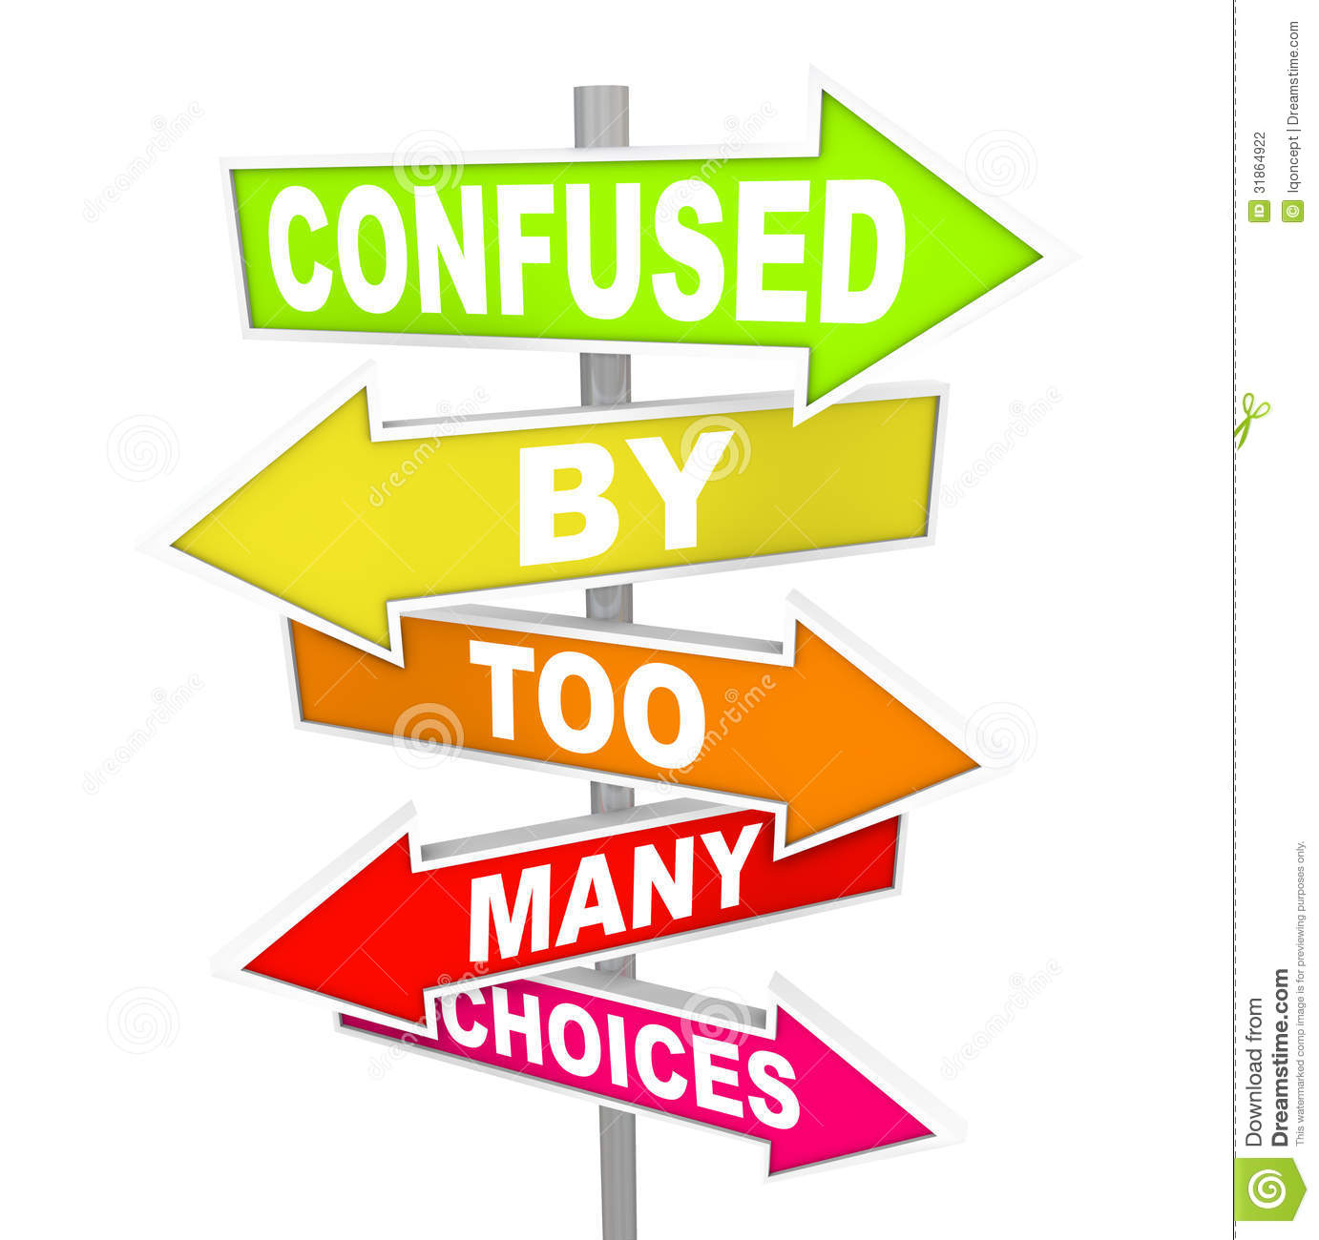
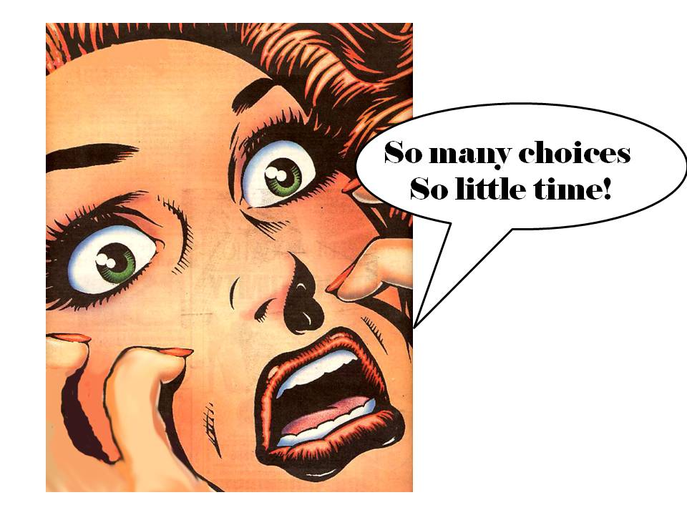


PHP IDEs
Choosing an IDE is a mater of personal choice.
Notes:
IDEs make developing complex code projects easier.

Slide 52
PHP IDEs
Site point survey on the internet…Best PHP IDE in 2014 – Survey Results
Comes up with three popular choices that I can recommend
PhpStorm
Sublime Text 3
and NetBeans
Notes:
IDEs make developing complex code projects easier.

Slide 53
PHP IDEs Homework
Over the weekend, visit the following pages and evaluate the top three IDE for PHP for yourself. Choose one, and start to use it.
Notes:
IDEs make developing complex code projects easier.

Slide 54
PHP IDEs
PhpStorm
from JetBrains
Notes:
IDEs make developing complex code projects easier.

Slide 55
PHP IDEs
Sublime Text 3
From sublimetext.com
And you may want to read this article too
Notes:
IDEs make developing complex code projects easier.

Slide 56
PHP IDEs
NetBeans
from Netbeans.org
And see this guide on setting up Netbeans with PHP.
Notes:
IDEs make developing complex code projects easier.

Slide 57
XAMPP Live Demo
Switch to XAMPP Control Panel for live demonstration of MySQL and PHPMyAdmin interface
Notes:
If there is leftover time…

